Slide 1
Power System Fault Detection and Classification
CAPSTONE PROJECT
Presented By:
Student Name- Rithiga M
College Name- J.P.College of Engineering
Department- Computer Science and Engineering

Slide 2
OUTLINE
Problem Statement
Proposed System/Solution
System Development Approach
Algorithm & Deployment
Result (Output Image)
Conclusion
Future Scope
References

Slide 3
Problem Statement
Design a machine learning model to detect and classify different types of faults in a power
distribution system. Using electrical measurement data (e.g., voltage and current
phasors), the model should be able to distinguish between normal operating conditions
and various fault conditions (such as line-to-ground, line-to-line, or three-phase faults).
The objective is to enable rapid and accurate fault identification, which is crucial for
maintaining power grid stability and reliability.

Slide 4
Proposed Solution
The proposed system addresses the challenge of fault detection and classification in power systems using intelligent techniques. It involves:
Data Collection: Collect time-series electrical parameters like voltage and current under different fault scenarios.
Data Preprocessing: Clean and normalize the dataset, remove outliers, and label the fault categories.
Feature Engineering: Extract fault-relevant features such as symmetrical components, RMS values, or wavelet coefficients.
Modeling: Use classification algorithms (e.g., Decision Tree, SVM, Random Forest, or CNN) to classify fault types.
Real-Time Monitoring: Integrate the model with a monitoring system for real-time fault detection.
Evaluation: Assess accuracy, precision, recall, and F1-score of the classifier using confusion matrix and cross-validation.

Slide 5
System Approach
System Requirements:
Python, Jupyter Notebook/Colab
Libraries: Pandas, NumPy, Sci-kit Learn, Matplotlib, TensorFlow/Keras (if deep learning used)
Hardware Requirements:
Simulation tools (e.g., MATLAB/Simulink or PSCAD) for data generation
Intel i5/i7, 8GB+ RAM (for model training)

Slide 6
Algorithm & Deployment
Algorithm Selection: Random Forest and CNN were considered for their ability to handle non-linear and sequential data, respectively.
Input Data: Voltage and current signals (in time or frequency domain), with labeled fault categories.
Training Process: Model trained using simulation data under varied fault and non-fault conditions, with k-fold cross-validation.
Prediction Process: Real-time input streamed to the model; output gives both fault existence and type.
Deployment: Flask-based web application or cloud deployment using IBM Cloud/AWS for live monitoring.

Slide 7
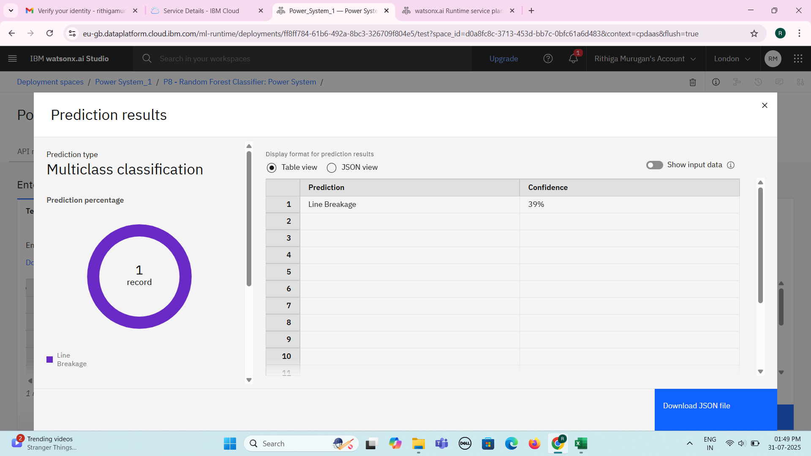
Result
Classification Accuracy: ~95%
Time to detect faults: < 0.5 seconds
GitHub Link: https: https://github.com/codebyrith

Slide 8
Conclusion
Successfully built a model for real-time fault detection and classification
Demonstrated the applicability of machine learning in power systems
Helped reduce diagnosis time and enhanced grid response
Real-time system provides high fault detection accuracy

Slide 9
Use real-world SCADA data for improved reliability
Expand classification to include severity or location of fault
Integrate with IoT-based smart grid platforms
Deploy on edge computing devices for ultra-low-latency detection
Future scope

Slide 10
References
IEEE Papers on Power Fault Classification
Sci-kit Learn Documentation
Research on Wavelet-Based Fault Detection
MATLAB Simulink Toolboxes
TensorFlow/Keras Documentation

Slide 11
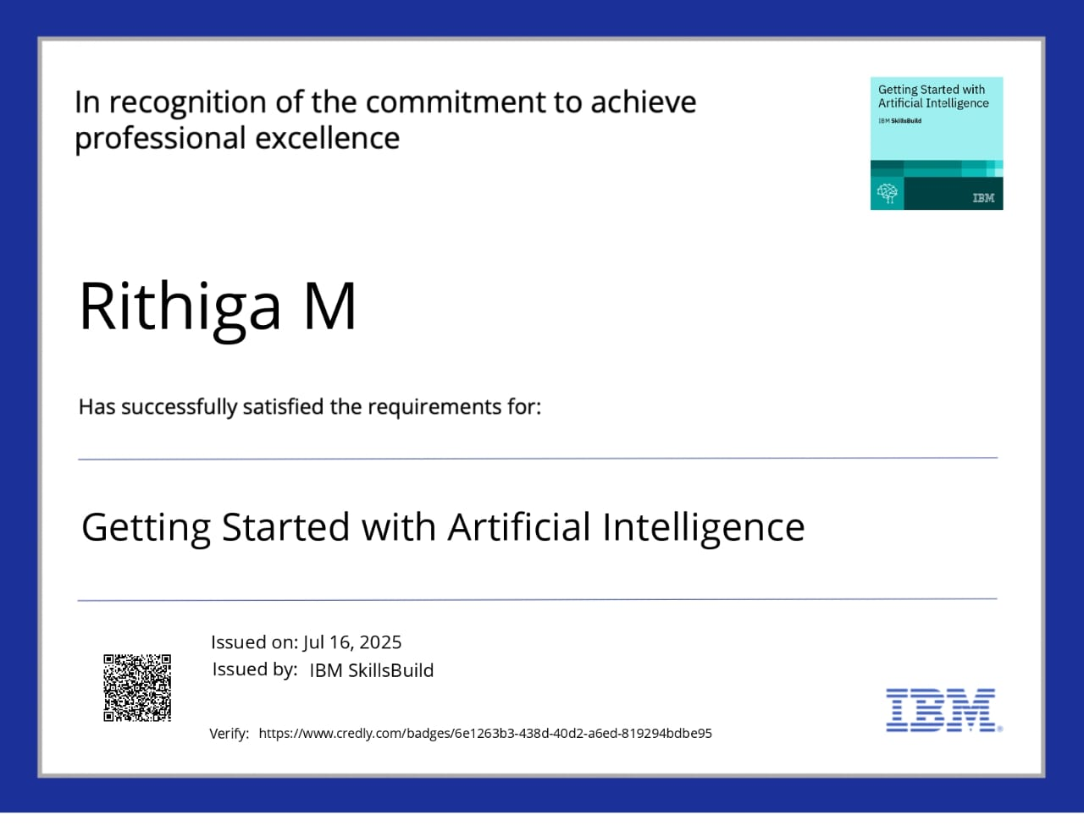
IBM Certifications

Slide 12

IBM Certifications

Slide 13
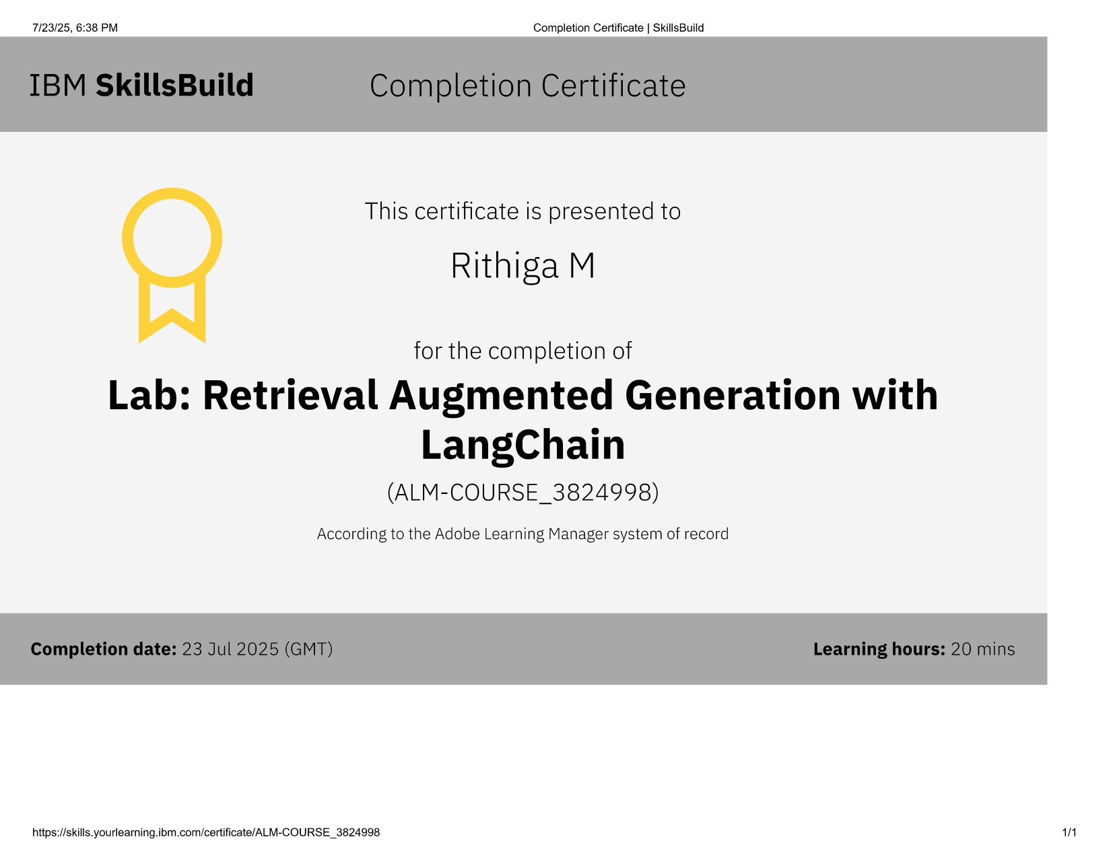
IBM Certifications

Slide 14
THANK YOU

